Slide 1
Pyrethrins and Pyrethroids
Tony Rianprakaisang, MD and Adrienne Hughes, MD
September 5th 2018

Slide 2
May 12th, 2005 – Kern County, CA
7:00 am: Pesticide application team begin spraying in a citrus orchard in Kern Co, CA
Pesticide solution:
  32 oz cyfluthrin (pyrethroid)
  84 oz spinosad
  18.5 gallons petroleum oil
  18K gallons water

Slide 3
27 farmworkers in neighboring vineyard
Not aware of cyfluthrin application in the nearby citrus orchard

Slide 4
Several vineyard workers noticed a chemical odor & began feeling ill
911 phone call was made
7:55am: HAZMAT team arrived
27 exposed farmworkers
23 decontaminated on site
All transported to medical care for evaluation

Slide 5
Learning Objectives
Learn about historical uses and classification systems of pyrethrins/pyrethroid
Learn about different types of pyrethroids and factors that influence toxicity
Understand characteristics of exposure to pyrethroids and clinical management

Slide 6

Pyrethrins - Background
Used in China since 1st century AD for insecticidal properties
Commercial applications since 1800’s
Organic extraction to isolate pyrethrin compounds
Photosensitive – easily degrade
Chrysanthemum cinerariaefolium
Notes:
Ground chrysathemum flowers have approximately 1-3% active pyrethrins, must be extracted and concentrated using organic solvents like alcohol, kerosene, naptha
Pyrethrins easily degrade in acid, alkalai, or UV light

Slide 7
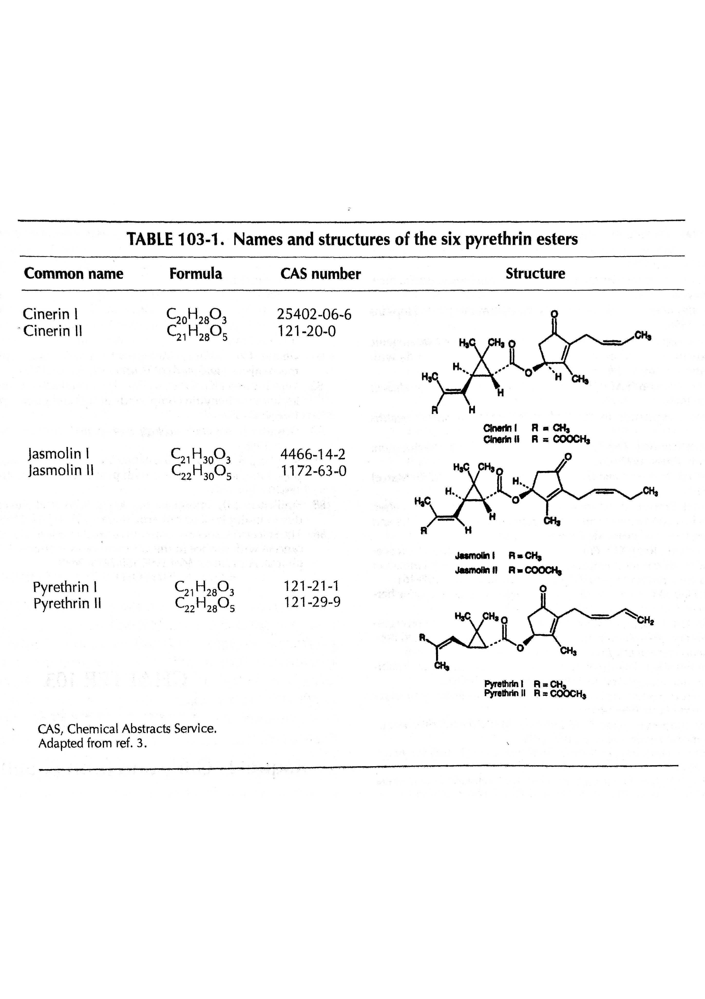
Pyrethrins

Slide 8

Pyrethroids
Synthetic analogs of pyrethrins
Originally produced in 1940’s
Most contain chiral centers
  Significant impacts on activity
  Cis typically more potent than trans
Typically more potent than natural derivatives
Notes:
- developed as a more environmentally stable alternative to pyrethrins
Other factors that increase toxicity – temperature (typically lower temperature increases toxicity), halogenation
More selective than pyrethrins – can be safer than pyrethrins and less toxic to mammals

Slide 9
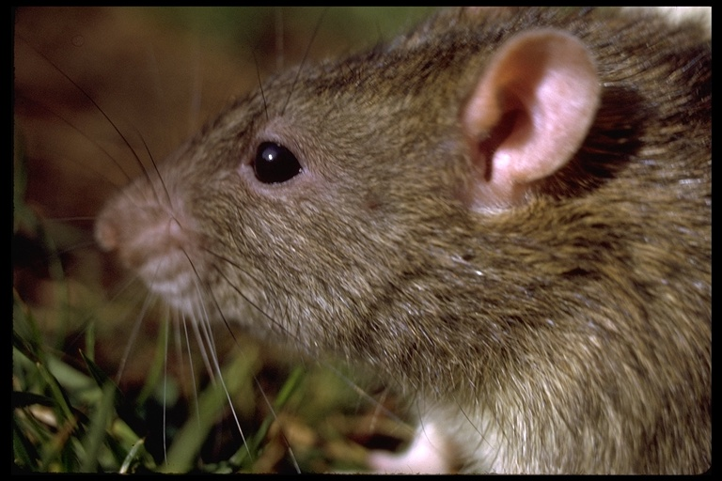
Pyrethroid Classification
Originally classified based on toxic syndromes:
  T syndrome (pyrethrin and most non cyano-containing pyrethroids)
  CS syndrome (most cyano containing pyrethroids)
Notes:
Divided into 2 types
T syndrome – tremor seen in rats after IV administration – type 1
CS syndrome (choreoathetosis and salivation)
Original Classification system failed to characterize new pyrethroids, and testing involved IV and Intracerebral administration to animals, which does not represent toxicity in humans

Slide 10
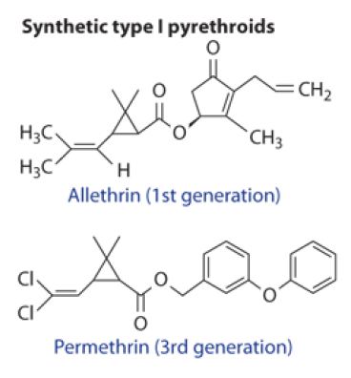
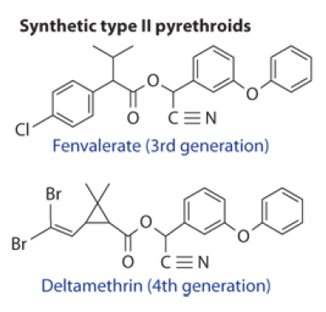
Pyrethroid Classification
Notes:
New classification is based on structure: Type 1 pyrethroids have a simple ester bond linkage, whereas Type 2 pyrethroids contain a Cyano group
Cyano group confers significantly more neuro toxicity

Slide 11

Exposure
Common routes of exposure
  Dermal
  Inhalational
Distribution
  Highly lipid soluble
  No significant bioaccumilation
Notes:
-Often exposure occurs due to failure in PPE, also mixing of chemicals by hand or sloppy handling
No significant absorption dermally, but occular exposures have occurred as have accidental ingestions
Lipid solubility – prefers to remain with solvent rather than be taken up by GI tract, often found unchanged in feces in ingestions

Slide 12
Metabolism and Elimination
Metabolism
  Poor absorption from GI tract
  Metabolism by liver
Parent compounds excreted rapidly and completely
  Urinary (40-60%)
  Fecal (30-50%)
Notes:
Metabolized to CO2 via hydrolysis, oxidation and conjugation reactions
Trans isomer much more rapidly metabolized and less toxic than cis isomers
Newborn animal models seem to display more toxicity due to poor ability to oxidize and hydrolyze
-90% Excreted in 24-48 hours, the remaining parent comppound can take days, and metabolites can take even longer

Slide 13
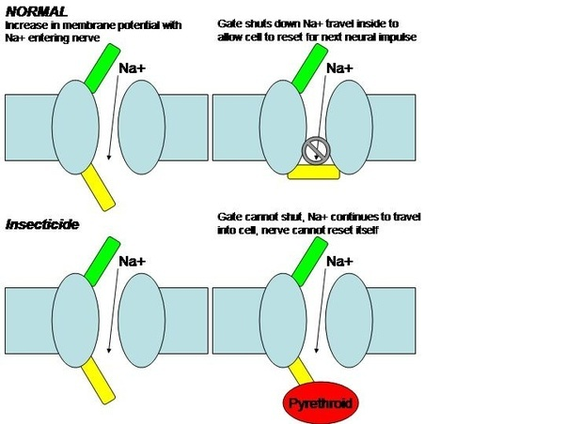
Mechanism
Notes:
Pyrethroids cause prolonged opening of sodium channel and increase in intracellular Na. Experimentally 1000 fold stronger affinity for insect sodium channels than mammalian, which results in 15000-fold increase in toxicity
Type I pyrethroids:
cause repetetive depolarization and clinically manifest as tremors jerking movements
Type II pyrethroids
cause continuous depolarization that leads to total blocking of impulses due to prolonged depolarization
Also thought ot inhibit GABA at the picrotoxin binding site – may explain seizures

Slide 14
Clinical Manifestations
Allergies – cross reactivity to ragweed
  Rhinitis, dermatitis, bronchospasm, anaphylaxis
Dermal symptoms
  2-4 hours post-exposure
Inhalational
  Predominance of upper respiratory sxs
Ingestion
Notes:
Overall considered low order toxicity to mammals, but highly insecticidal
Allergic reactions are common – over 50% of persons allergic to ragweed have allergy to pyrethrins, as chrysathemum is in the same genus
Dermal exposure:
within 2-4 hours of exposure – rashes, blistering, parasthesias.
Facial exposure – lachrymation photophobia, congestion. Symptoms exacerbated by sweating and washing with warm water
Typical dermal exposure from ungloved mixing
Inhalational exposure:
Typically from spraying against the wind, cleaning sprayer nozzles, being near sprayer without PPE
Upper respiratory symptoms more common: itchy throat, sneezing, laryngeal edema
Lower respiratory symptoms less common: cough, wheezing, bronchospasm, pneumonitis, pulmonary edema
Ingestion: rapid onset of symptoms – 10 mins to 1 hour. Epigastric pain nausea and vomiting

Slide 15
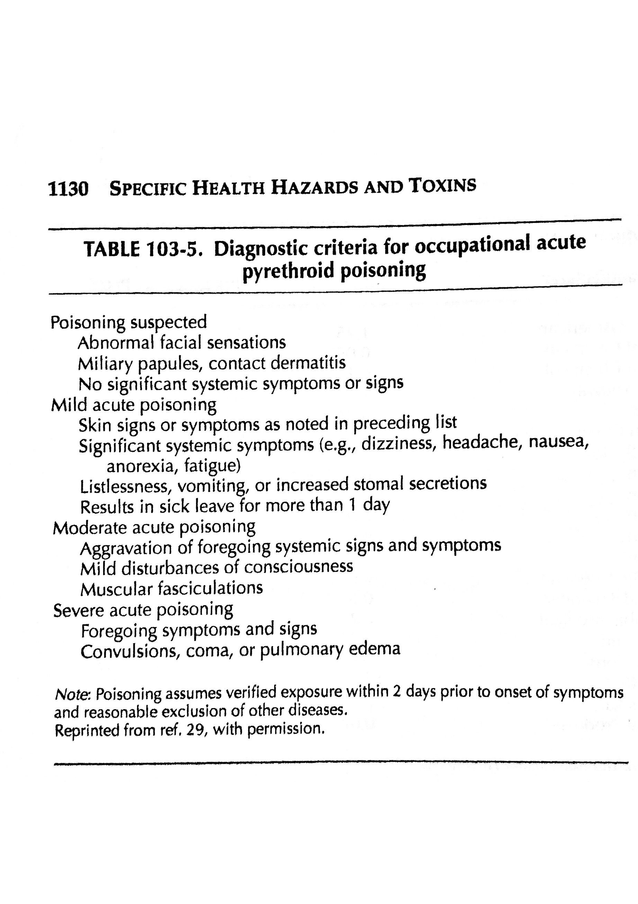
Occupational Exposures
Notes:
26.8% of occupational exposures will manifest symptoms
Most common symptoms – facial tingling, dizzines, HA, fatigue, nausea
Moderate acute poisoning
Includes changes in mental status, large muscle fasciculations
Typically symptoms resolve in 1-6 days
Severe Poisonings
Coma and seizure
Pulmonary edema – often difficult to differentiate from organophospate toxicity – plasma cholinesterase activity may be useful → failure to recognize the diference this has resulted in iatrogenic atropine toxicity and death

Slide 16
T Syndrome vs CS Syndrome
T syndrome (tremor)
  Tremor
  Increased sensitivity to external stimuli
  Hyperthermia
CS syndrome (choreoathetotic, salivation)
  Salivation
  Choreoathetosis
  Increased startle response
  Tonic clonic seizures
Notes:
In general 2 syndromes present after pyrethroid poisoning
T syndrome (tremor) from type I pyrethroids, resembles DDT toxicity
CS syndrome – caused by type 2 – cyano containing pyhrethroids

Slide 17
Management
No specific treatments
Irrigation and decontamination
Consideration of co-contaminants
  Solvents
  Hydrocarbons
Management of muscular symptoms
Seizure management
Notes:
Clothes may need to be thrown away – some studies suggest even multiple washings have limited removal of pyrethroids
Skin exposures – soap and water at least x2
Activated charcoal if not contraindicated
Pyrethroids bind well to charcoal and are enterohepatically recirculated, MDAC maybe of use
Muscular symptoms – diazepam and methocarbamol may be useful
Seizures – difficult to control at times
3mg/kg of valium has been needed in animal studies
Barbs have not been found to be as helpful

Slide 18
Occupational Monitoring
Relative contraindications to working with pyrethroids
  Dermal lesions
  Asthma
  Peripheral or central nervous system disease
Monitoring
  No current exposure indices have been set for urine metabolites
  Can be detected in urine using GC/MS, and other detection methods
Notes:
Persons with symptoms from exposure may need further testing – electromyography may be useful, but cannot return until symptoms resolve

Slide 19
OSHA limits
Based on pyrethrum
  5mg/cubic meter – workplace limit
  5000mg/cubic meter – immediately life-threatening
High margin of safety
  Animals studies indicate very high exposure limits

Slide 20
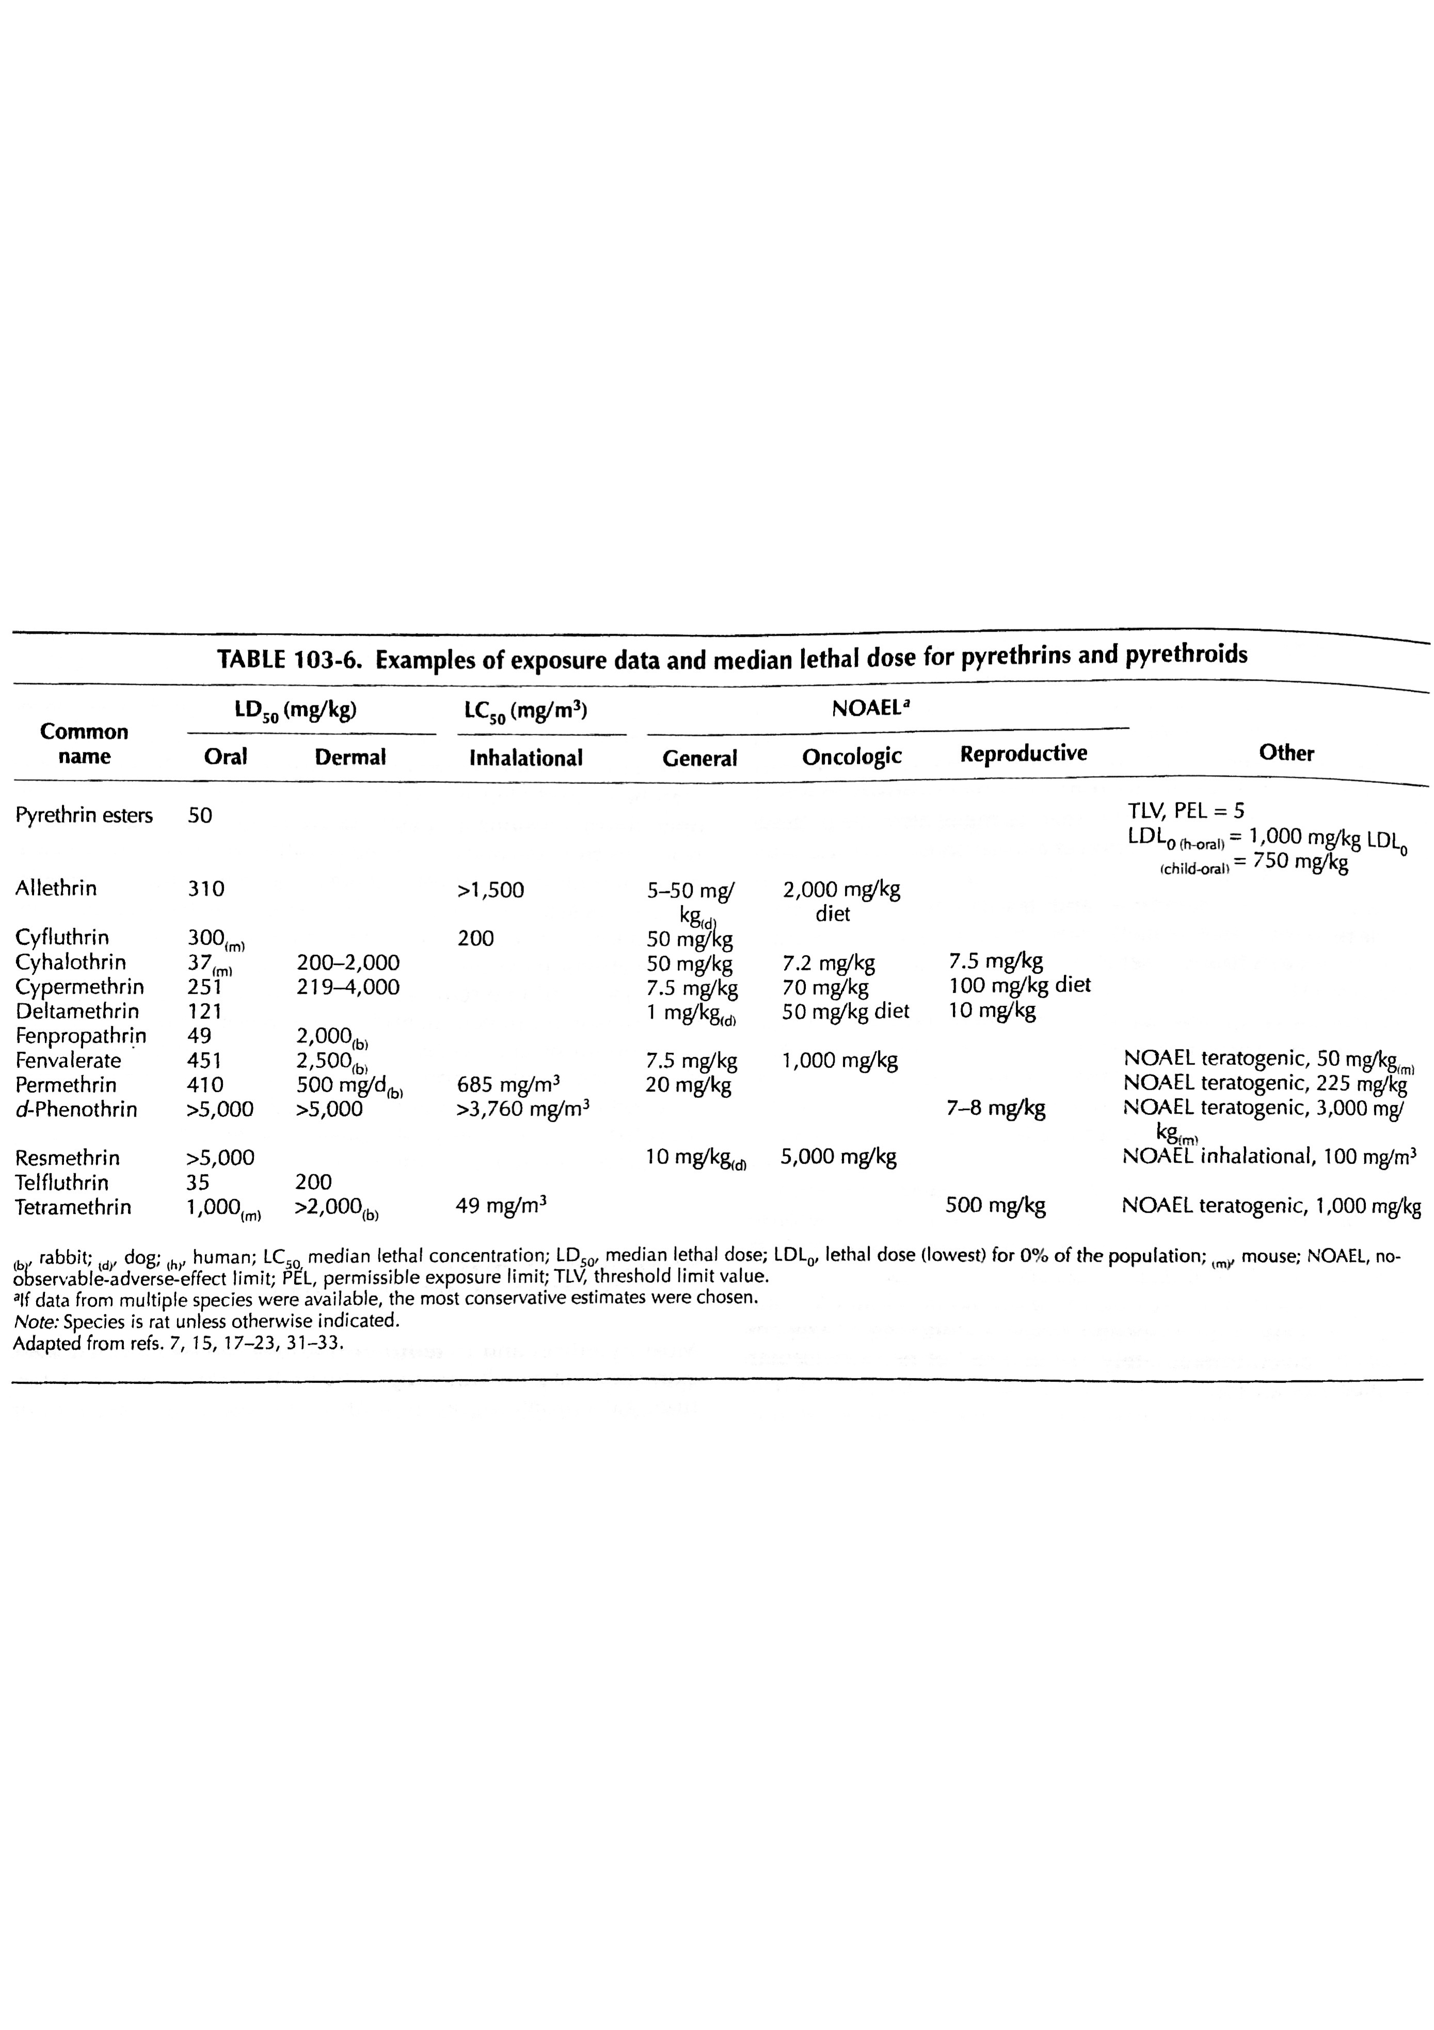
Pyrethroid Exposure Data

Slide 21


Slide 22
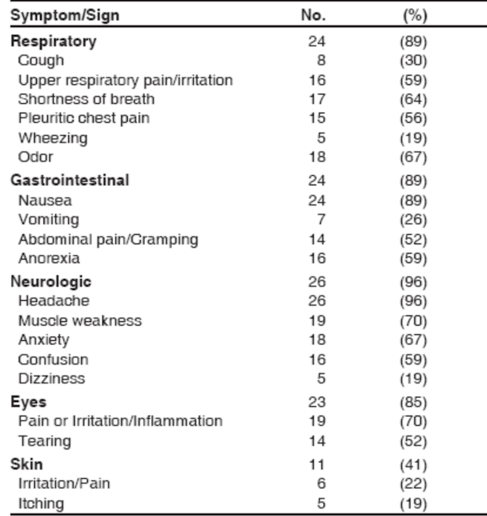
Back to the case
After evaluation in the ED, all 27 vineyard workers were discharged home
Illness severity:
  Moderate in five (19%)
  Low in 20 (74%)
  Not applicable in two (7%)
Because of the known toxicity of the different substances applied, these effects were attributed primarily to cyfluthrin

Slide 23
Back to the case
After evaluation in the ED, all 27 vineyard workers were discharged home
Illness severity:
  Moderate in five (19%)
  Low in 20 (74%)
  Not applicable in two (7%)
Because of the known toxicity of the different substances applied, these effects were attributed primarily to cyfluthrin

Slide 24
Back to the case
After evaluation in the ED, all 27 vineyard workers were discharged home
Illness severity:
  Moderate in five (19%)
  Low in 20 (74%)
  Not applicable in two (7%)
Because of the known toxicity of the different substances applied, these effects were attributed primarily to cyfluthrin

Slide 25
Back to the case
After evaluation in the ED, all 27 vineyard workers were discharged home
Illness severity:
  Moderate in five (19%)
  Low in 20 (74%)
  Not applicable in two (7%)
Because of the known toxicity of the different substances applied, these effects were attributed primarily to cyfluthrin

Slide 26
Back to the case
After evaluation in the ED, all 27 vineyard workers were discharged home
Illness severity:
  Moderate in five (19%)
  Low in 20 (74%)
  Not applicable in two (7%)
Because of the known toxicity of the different substances applied, these effects were attributed primarily to cyfluthrin

Slide 27
Back to the case
After evaluation in the ED, all 27 vineyard workers were discharged home
Illness severity:
  Moderate in five (19%)
  Low in 20 (74%)
  Not applicable in two (7%)
Because of the known toxicity of the different substances applied, these effects were attributed primarily to cyfluthrin

Slide 28
Foliage samples from citrus orchard
Foliage samples from grape vineyard & workers clothing
cyfluthrin levels of 1.14 ppm.
No measurable levels
of cyfluthrin

Slide 29
This case highlights 2 potential occupational hazards in agriculture:
Pyrethroid toxicity
Pesticide drift

Slide 30
Pesticide Drift
Airborne movement of pesticides from an area of application to any unintended site
Occurs:
  During application
  When droplets or dust travel away from the target site
  When some chemicals become vapors that can move off-site

Slide 31
Pesticide Drift
Drift of cyfluthrin was determined to be the cause of the symptoms in all 27 farmworkers
  Short distance between site of pesticide application & farmworkers
  Detection of cyfluthrin on foliage SE of spray direction (direction of farmworkers)
  Temporal relationship between application & symptom onset
  Symptoms consistent with those caused by pyrethroid pesticides

Slide 32
Pesticide Drift
1998--2003 in California, 12% (297 of 2,470) of occupational pesticide illness reports were attributed to pesticide drift
Contributing factors in this case:
  Unpredictable weather patterns
  Inadequate communication

